Slide 1
Convolution neural networks
Thushan Ganegedara

Slide 2

Fully connected neural networks
House price
y
w21
w22
h1 h2
w11
w12
w13
w14
# Bedrooms
Area
# Bathrooms
Postcode
x1 x2 x3 x4

Slide 3
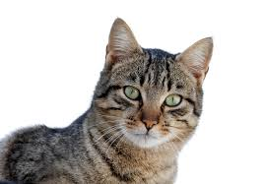
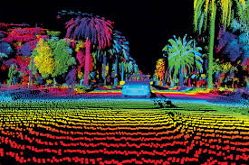
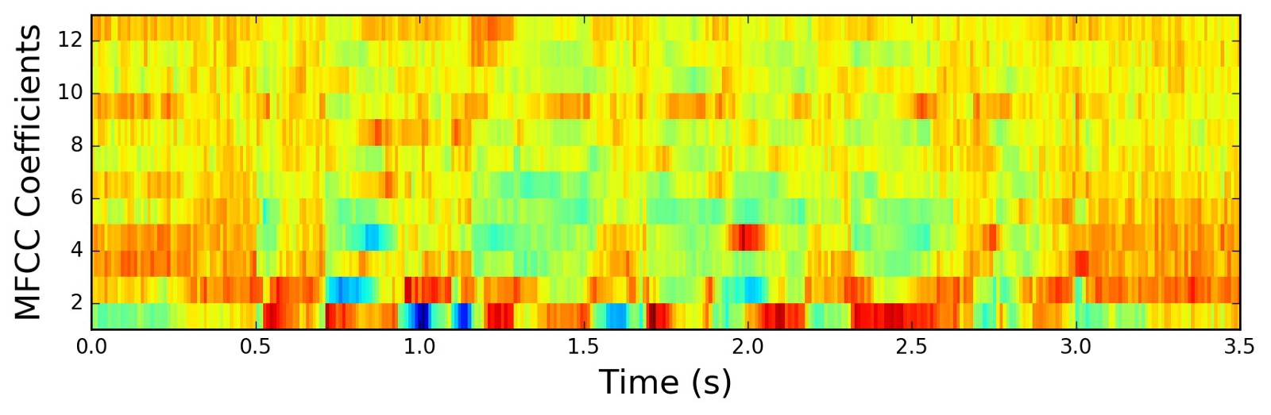
High dimensional data
?
Audio
Images
LIDAR

Slide 4
Let’s try a little experiment
Suppose you have following datasets
Grayscale images of digits 28x28 size
RGB images of various objects of 224x224x3 size
Let’s say you wanted to fit a neural network:
1000 hidden units
1 output node
Unwrap the image to a 1-D vector
Feed it to a neural network
Exercise: How many parameters are required?

Slide 5
Exercise: How many parameters are required?
The first FCN will require
28×28×1000+1000=785,000 (∼3𝑀𝐵)
The second network requires
224×224×3×1000+1000=150,529,000 (∼574𝑀𝐵) parameters
To put this into context, VGG-16 a SOTA 16-layer image recognition CNN only had 138,000,000 parameters

Slide 6
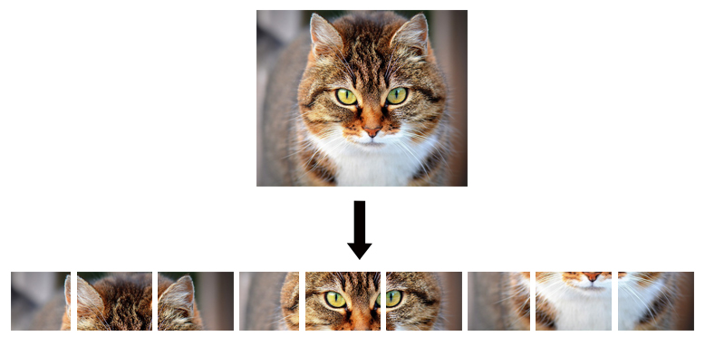
What else can happen?
We are losing precious spatial data
A FCN require it’s data to be 1-dimensional
When unwrapping an image (e.g. a cat) you are sacrificing quite a bit of spatial information

Slide 7
Enter CNNs!
A fresh paradigm to look at spatial high-dimensional data

Slide 8
Benefits of CNNs
Convolution neural networks are amazing because they solve both of these problems, i.e.:
They are parameter efficient so you can have a large number of layers without stifling your GPU
They preserve the spatial structure of data during the learning by using higher dimensional operations (e.g. 2 dimensional convolution)

Slide 9
Main components of a CNN
Convolution layers
Convolves a kernel over an image to produce a feature map
Convolution layers share parameters across the width and height of the image
Pooling layers
Convolves a kernel where at each position it outputs the maximum value of the output within the kernel
Make CNNs translation invariant (more on that later!)
Fully connected layers
Fully connected layers are important to use CNNs for a classification/regression problem
Give a way to globally combine the locally learnt features coming from convolution/pooling layers

Slide 10
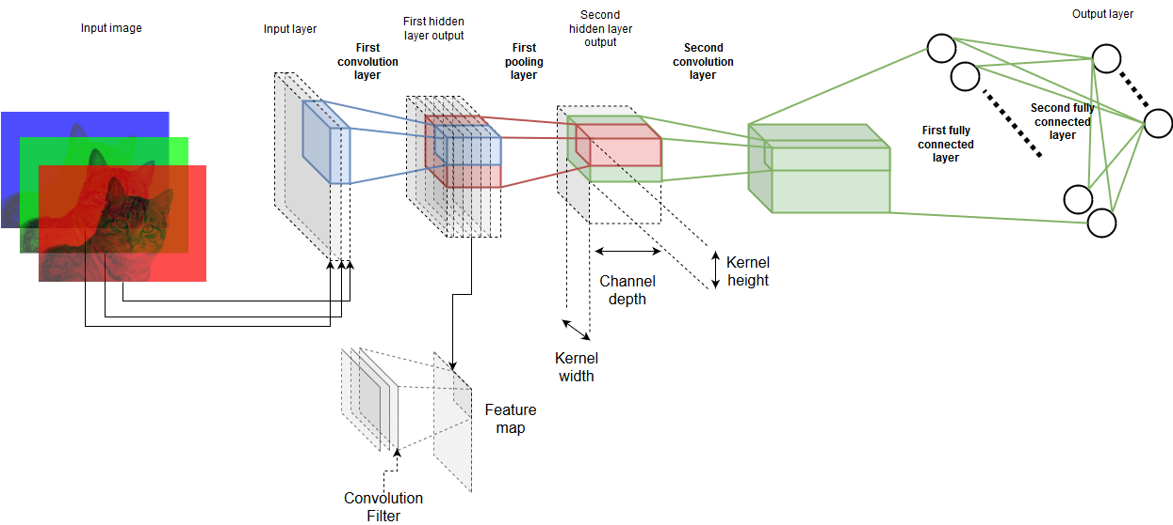
Anatomy of a CNN

Slide 11
Convolution Layer: Intuition

Slide 12
Pooling layer: Intuition

Slide 13
Implementing a CNN with TensorFlow

Slide 14
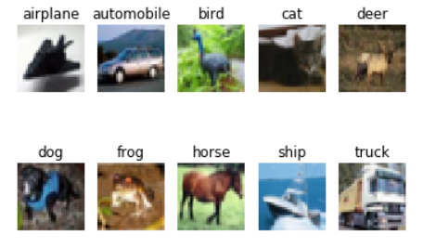
CIFAR-10: Introducing data
Image classification dataset
32x32x3 RGB images
10 different classes
50000 training samples
10000 testing samples

Slide 15
Downloading the data
Downloading the data
What it looks like?
Pickle dictionary with two keys; data and labels
Data → 40000x3072 matrix
Label → 40000 element long list/array

Slide 16
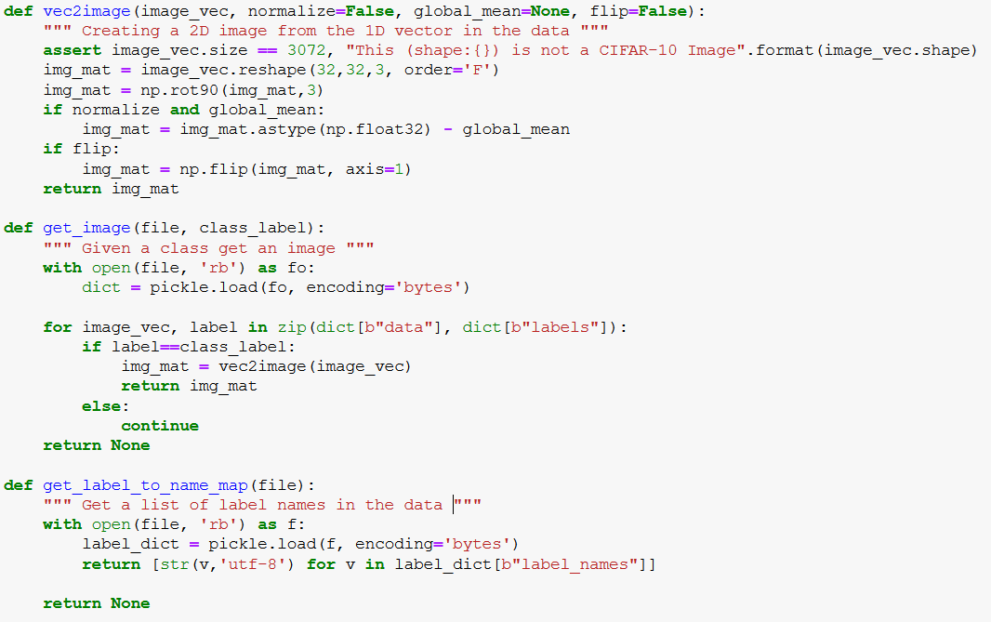
Preparing the data
Convert 3072 element vector to a 32x32x3 matrix
Normalize
Flip image
Get an image for a given label
Get a list of string where the item at index i is the name of that label

Slide 17
Implementing the CNN
Defining the CNN graph
Convolution layers
Pooling layers
Fully-connected layers
Defining inputs/output and computing predictions
Defining the loss
Defining an optimizer
Executing the graph

Slide 18

Implementing the CNN
Defining input placeholder
Convolution layer
(kernel height, kernel width, prev layer depth, current layer depth)
(batch stride, height stride, width stride, channel stride)
Can be “SAME” (same as input size) or “VALID” (no padding)

Slide 19
Convolution Layer: Operational view
kernel
Source: https://commons.wikimedia.org/wiki/File:3D_Convolution_Animation.gif

Slide 20
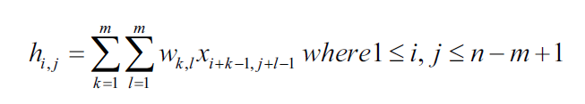
Convolution Layer: Mathematical form
Kernel Input

Slide 21

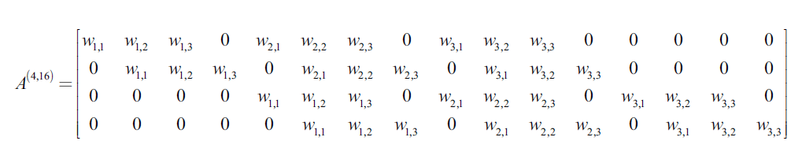

Looks like a very slow process
In fact convolution can be interpreted as a matrix multiplication

Slide 22
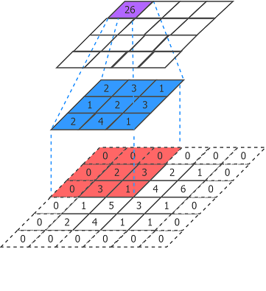
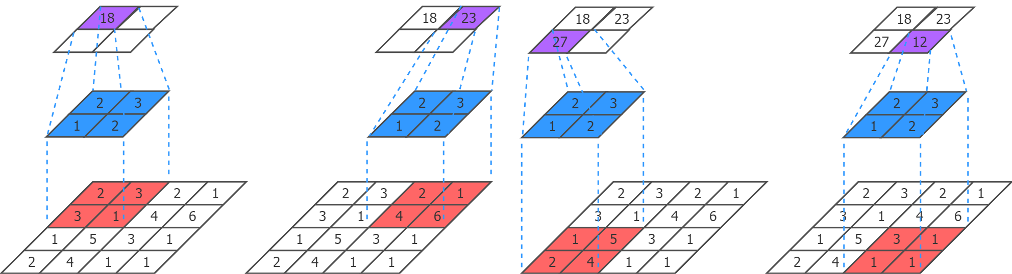
Convolution layer: Stride and Padding
Convolution with a stride of 2 (width) and 2 (height)
Convolution with padding

Slide 23

Implementing the CNN
Pooling layer
Max pooling
Average pooling
(batch kernel size, kernel height, kernel width, depth kernel size)
Can be “SAME” (same as input size) or “VALID” (no padding)
(batch stride, height stride, width stride, depth stride)

Slide 24
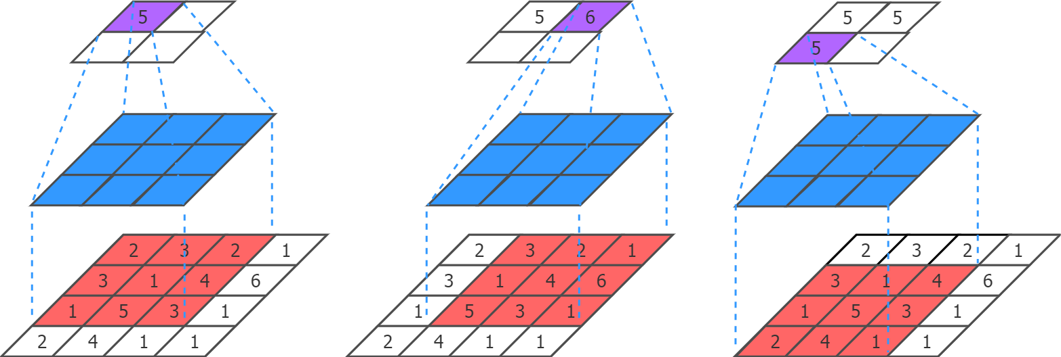
Pooling layer: Operational view
Output
Kernel
Input

Slide 25
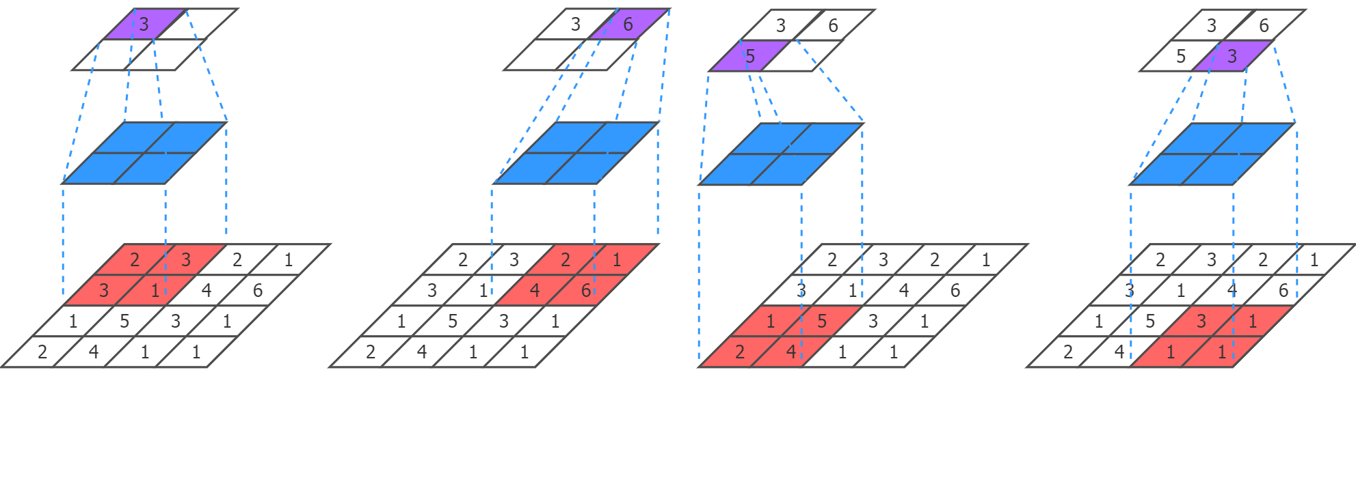
Pooling layer: Stride and Padding
Pooling with a stride of 2 (width) and 2 (height)

Slide 26
Implementing the CNN
Fully-connected layer
Before feeding the last convolution/pooling output to the first FC layer
Computing the output of the FC layer
Convolution output (e.g. 2x2x64) Unwrapped output (e.g. 256 units)
(in size, out size)

Slide 27
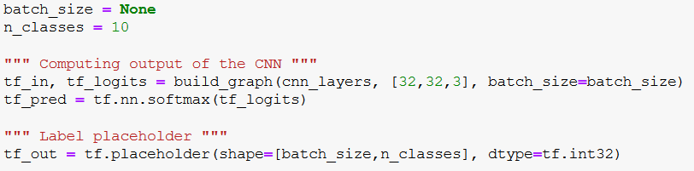
Defining Inputs/Predictions/Labels

Slide 28
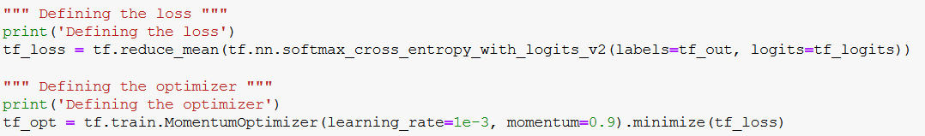
Defining loss/optimization

Slide 29
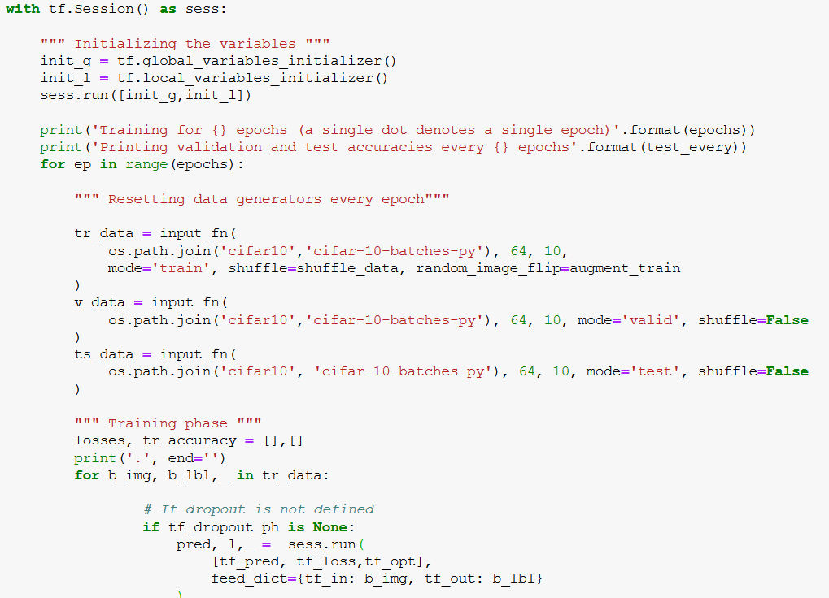
Running the CNN
We execute the graph within a session
Initialize global/local variables
Generating training/validation/testing data
Running a single optimization step

Slide 30
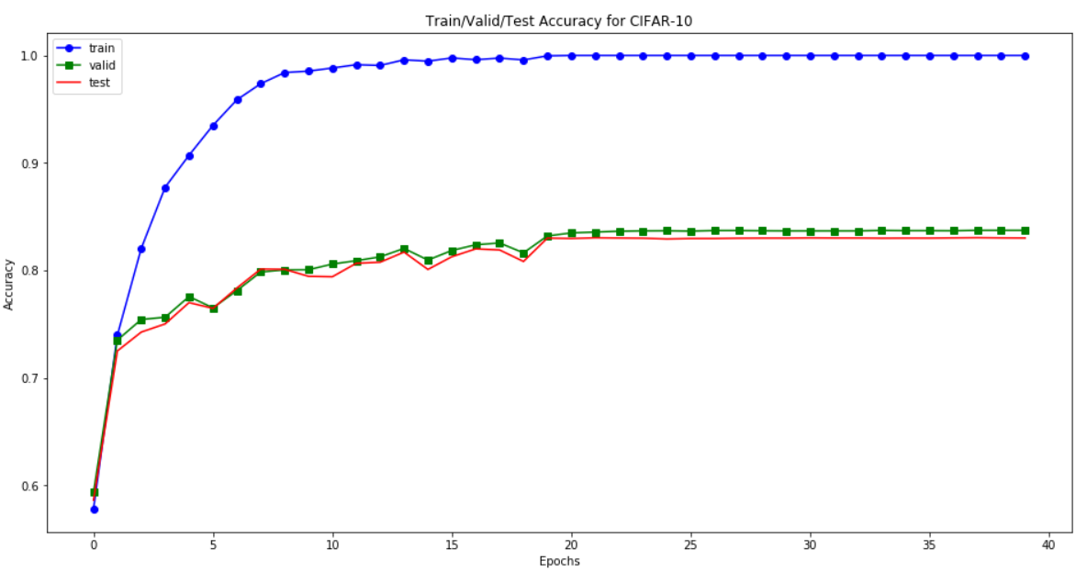
What results look like?
Anything wrong?
Why doesn’t validation/test accuracy go down after a while?

Slide 31
How can we fix this?
Data augmentation
Random cropping
Flipping images left-right
Dropout
Better optimizer
Adam
Batch normalization

Slide 32
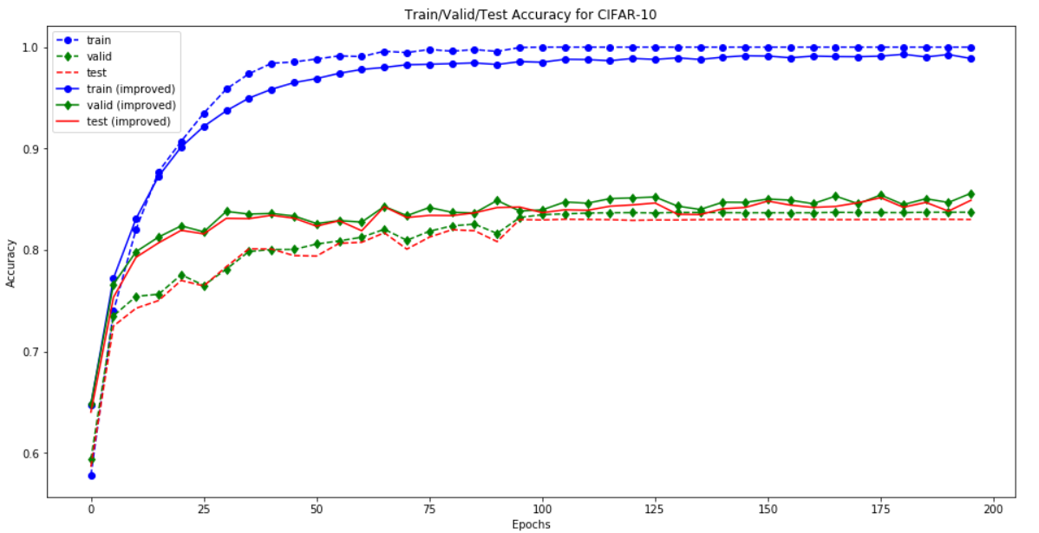
How the results look like?

Slide 33
Implementing a CNN with Keras

Slide 34
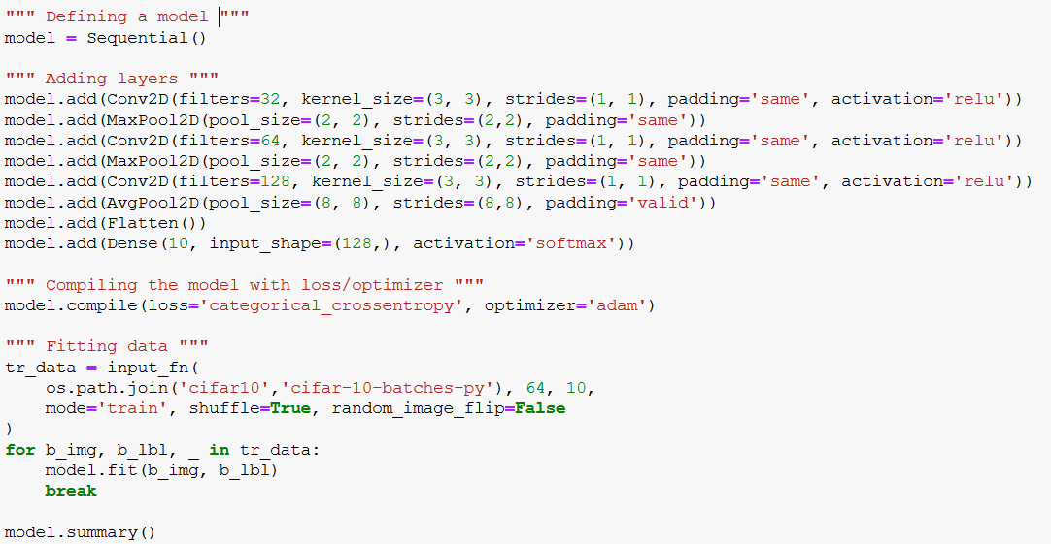
Implementing Keras CNN

Slide 35
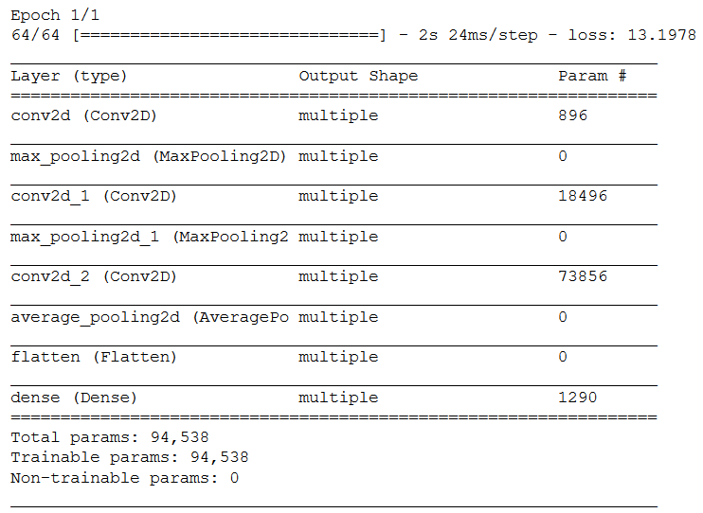
What the model looks like

Slide 36
Conclusion
CNNs are great for learning from spatial data
A typical CNN has:
Convolution layers
Pooling layers
Fully-connected layers
TensorFlow provides many builtin functions to implement CNNs
Dropout/Batch-normalization can greatly help to reduce overfitting
It is much easier to implement a CNN with Keras

